Slide 1
1.1. Clarify decision and decision maker
2.1. Stakeholder identification
1.2. Identify
experts
2.2. Stakeholder selection
1.3. Characterize intervention
3.1. Analying organizational decision-making process
1.4. Generate conceptual model
2.4. Further categorize stakeholders based on their attributions
Iterative and reflective processes
1.5. Develop mathematical model
Suggest potential pathways for engaging stakeholders
Refine model
2.3. Aggregate cost-benefit analysis for
each stakeholder
1.6. Simulate and analyze data
1.7. Share results, receive feedback
Decision analysis steps
Stakeholder identification and analysis steps
Policy and organizational decision-making analysis
Recommendations for engaging stakeholders

Slide 2
Stakeholder identification
Step
Methods
Desk review
Focus group discussion
Expert opinion
Snowball sampling
Previous studies
Tools/techniques
Brain storming
Questionaire
(project managers,
network expert)
Organizational charts
Mind Mapping
Project reports
Advocacy plan
Value chain analysis report

Slide 3

Step 2: Stakeholder Categorization and Analysis
Stakeholder categorization
Analytical categorization: Top-down
Stakeholder led categorization: Bottom-up
Experience-availability -expertise anlysis
Identify experts
Interest – Influence matrix
Engage stakeholders
https://www.researchgate.net/publication/228598959_Stakeholder_Categorisation_in_Participatory_Integrated_Assessment_Processes

Slide 4
BUDGET SYSTEM
EXECUTIVE ORGANS
(execution)
ELECTED ORGANS
(legislatiton)
Central
budget
Government of
Vietnam
State
budget
National Assembly
Ministry
Prepare
Approve
Province
Provincial
People’ Committes
Provincial
budget
Provincial
People’ Councils
Departments
State budget
Prepare
Approve
District
District
People’ Committes
District
budget
District
People’ Councils
Divisions
District budget
Approve
Provincial budget
Prepare
Commune budget
Commune units
Commune
People’ Committes
Commune
budget
Commune
People’ Councils
Prepare
Approve
Leadership relationship
Specialized
assistance
Supervision/ guidance
Supervision
Approve

Slide 5
Case study: Agro-climate information value chain
National Centre for Hydro-Meteorological Forecasting (NCHMF), Vietnam Meteorological Hydrological Administration (VMHA)
NorthWest Regional Centre for Hydro-Meteorological Forecasting
Centre for Agro-Meteorology, IMHEN (seasonal forecasts for regions)
MARD (agri-extenstion, animal husbandry, veterinary)
Tivi (VTV3; EM channel, VTV2)
Radio
Newspaper: Nhan Dan
Website
National
Weather and climate forecast generation
Translation forecasts into agricultural advice
Communication: Forecasts and advice
Use of information by farmers
Dien Bien Centre for Hydro-Meteorological Forecasting (4 stations)
Dien Bien Agro-meteorology Station (monitor for rice)
Department of Environment and Natural Resource (manage automatic rain gauge stations)
DARD (plant protection, agri-extension, Veterinary, animal husbandry, aqua-culture, water resource, forestry, forestry protection)
Disaster Prevention and Control Committee (Department of Water Resources)
District People Committee: District DARD: Plant protection, Agri-extension, Veterinary, forest protection
Commune People Committee: Agri-extension, Veterinary, Forest protection)
Village leader
Village agri-extension, collaborators
Dien Bien TV and Radio (24 and 48 hour weather forecasts)
District TV and Radio
Loudspeaker
Correspondence
Website: DONRE, Dien Bien Phu
Loudspeaker
Village leader (disasters warning)
SMS
Paper bulletin
Zalo
Phone app
Farmers: Rice, maize, vegetable, potato, cassava, coffee, peanut, soybean, fruit trees
Animal husbandry: Buffalo, Cows, Pig, chicken
Forest: Acacia
Aqua: Fish, shrimp
Poor, better off
EM
Male and female
Poor, better off
Fertilizer, Pesticides, Breeds service providers
Animal feeds, Veterinary medicine
Local
Notes:
Từng box phải khớp phía trên
How farmers prefer communication channels
Legend: Local and national

Slide 6
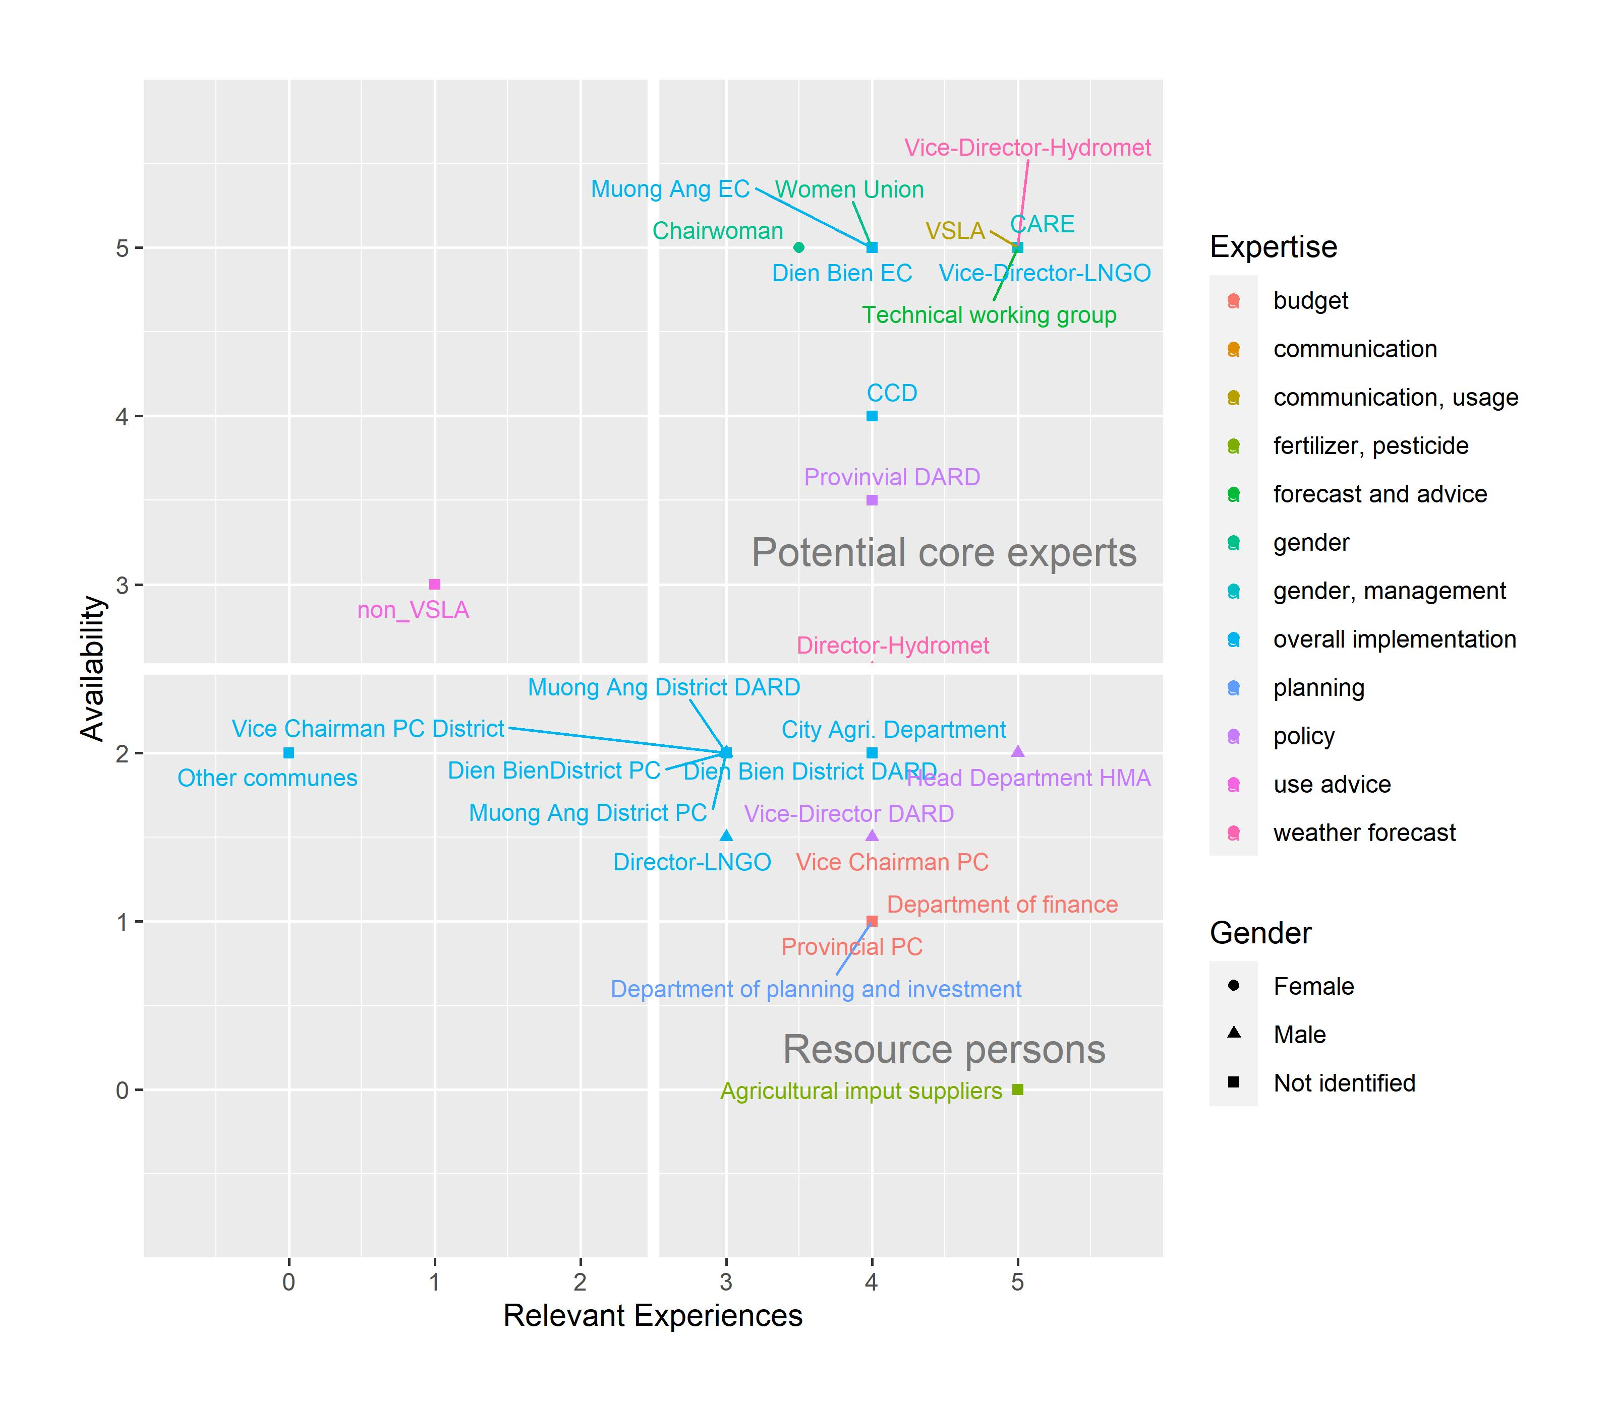
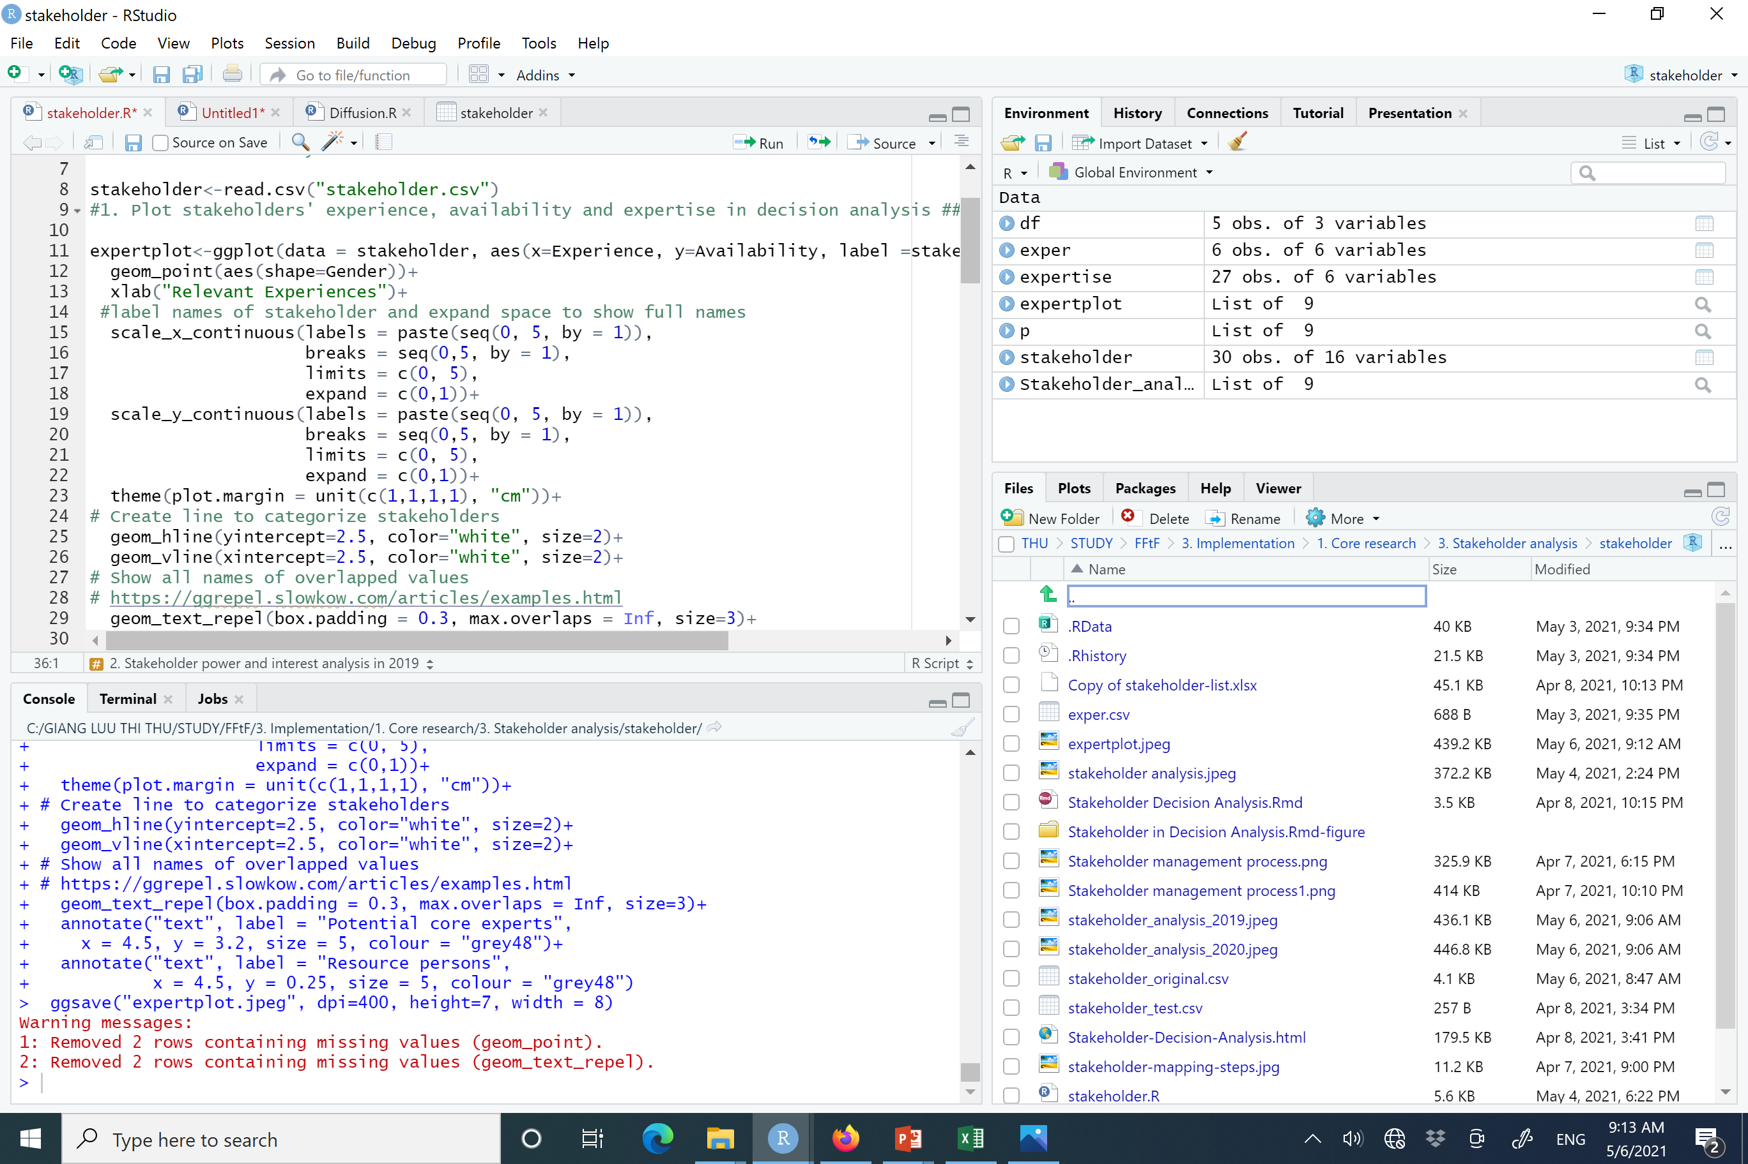
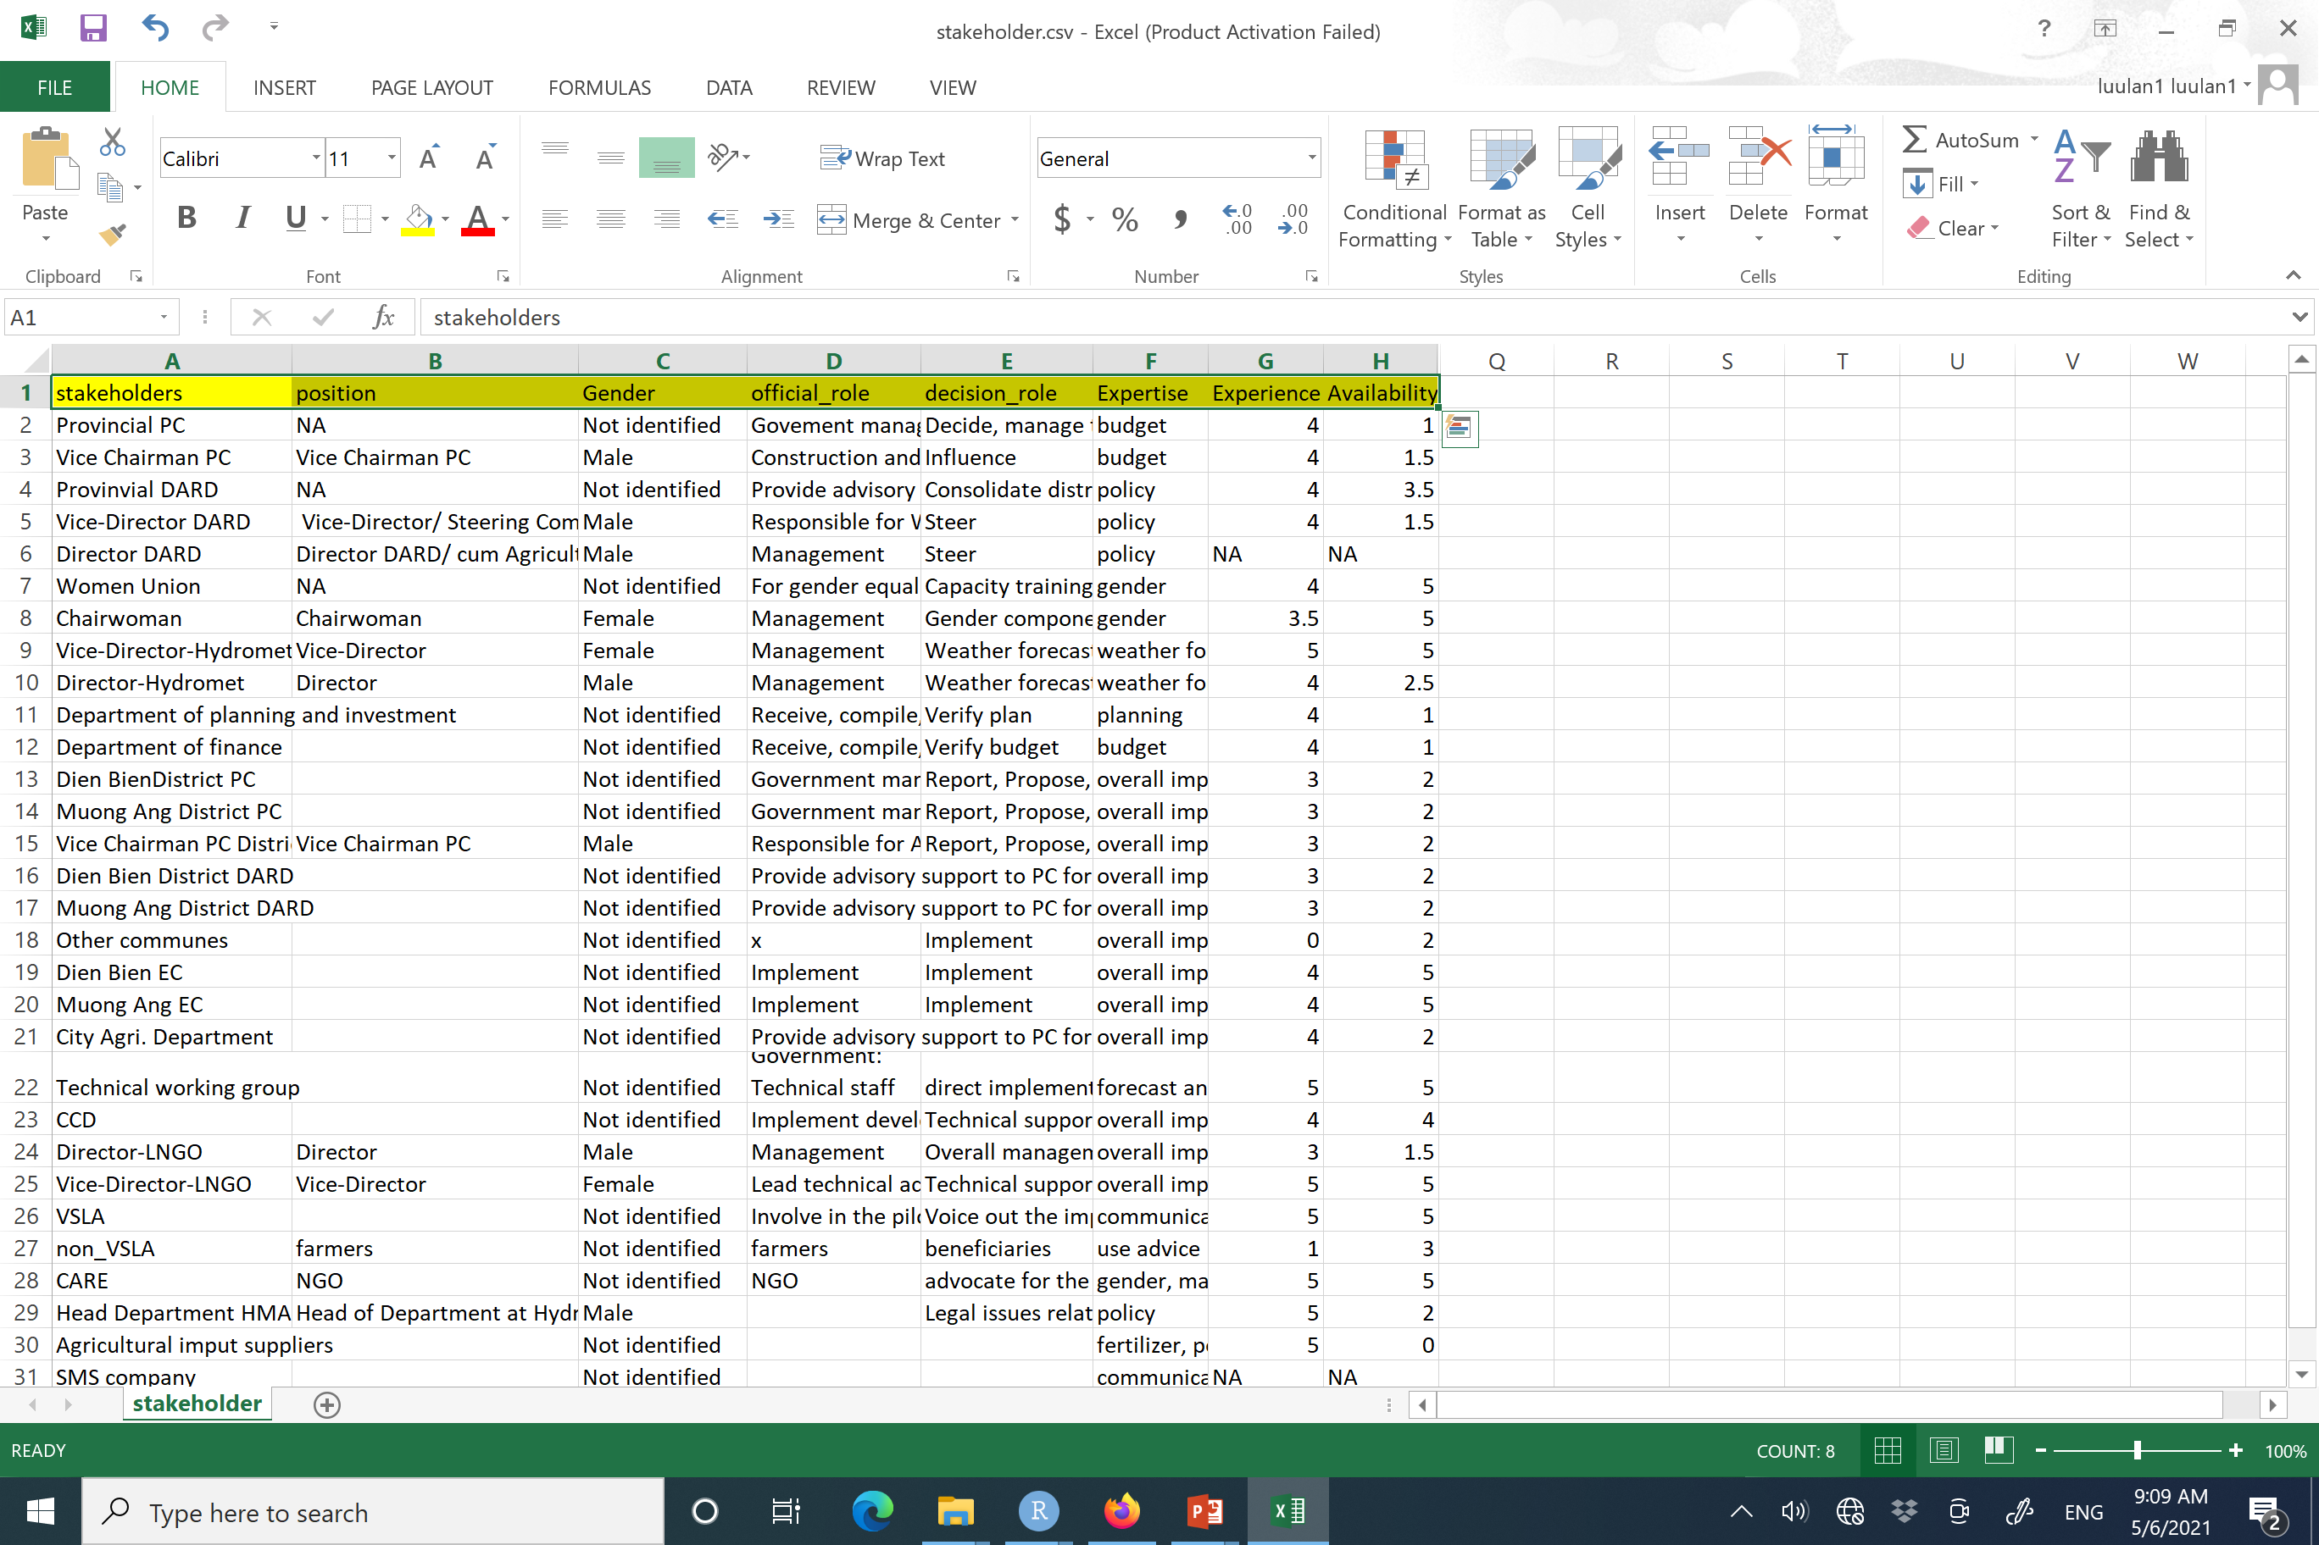
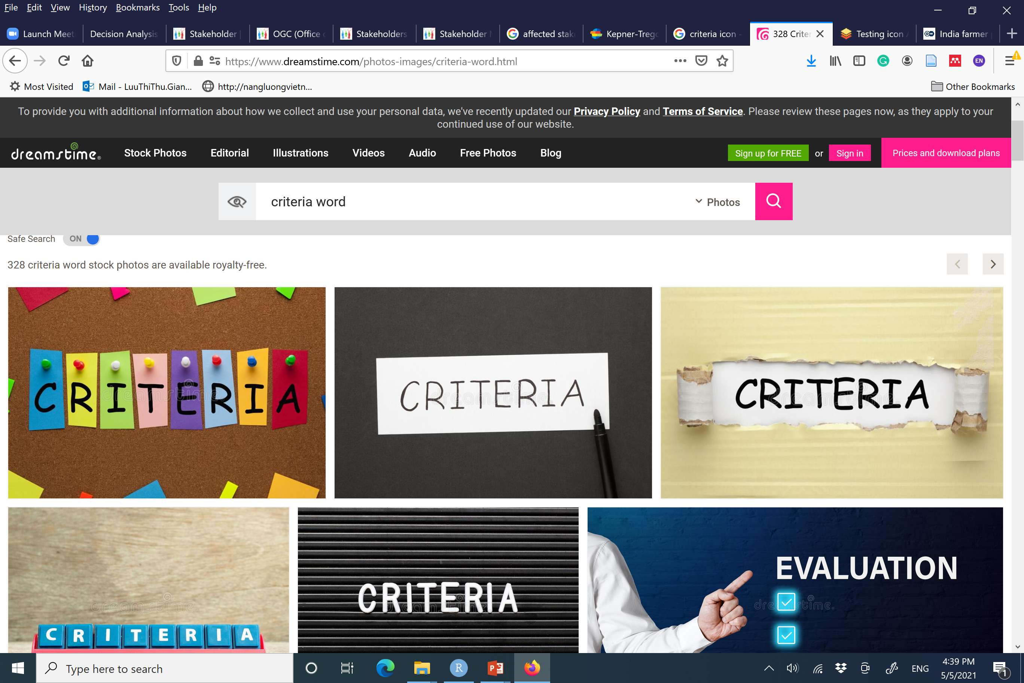
Case study
Attributions
Stakeholder categorization to identify potential experts
Thi Thu Giang Luu

Slide 7
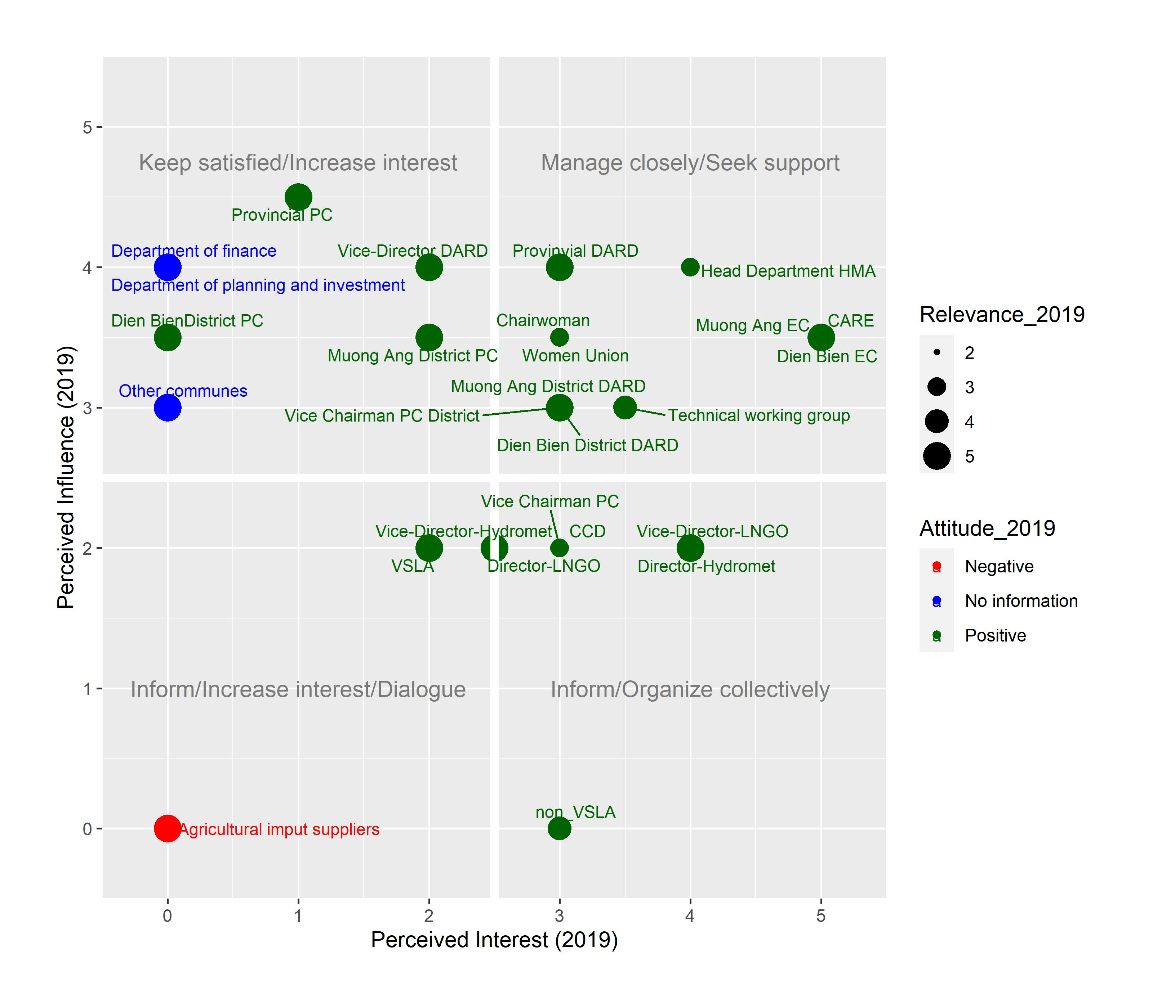
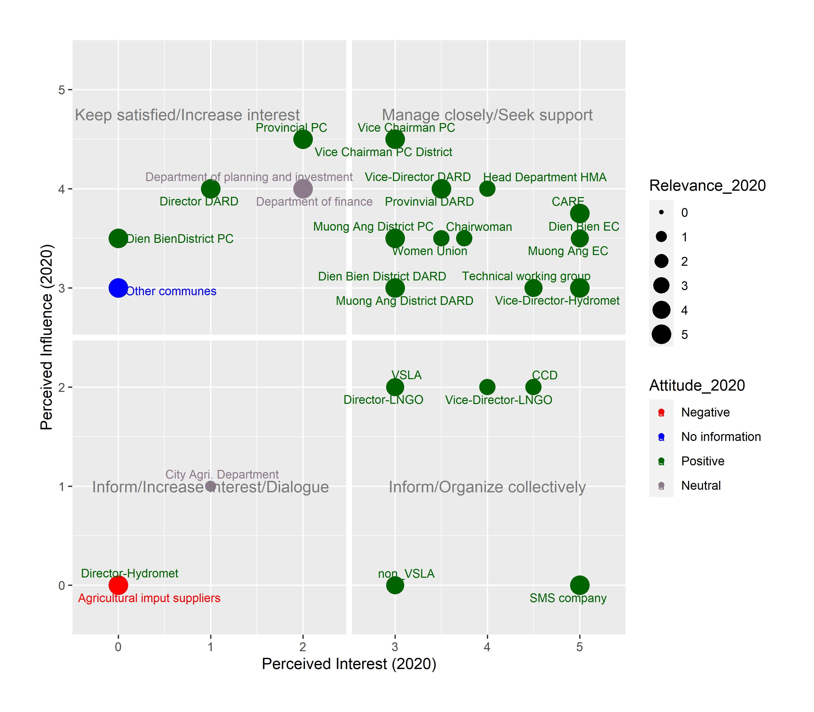
Case study: Stakeholder analysis for advocacy
2019
2020
Thi Thu Giang Luu

Slide 8
Thank you for your attention!

Slide 9
Example of questions to identify stakeholders
Who has an interest in the decision?
Who could affect the decision?
Who could be affected by the decision?
Who could have an interest in the outcome?
Which attributions might be used to categorize those stakeholders?
Can you recommend who else can provide more knowledge about other stakeholders?
Adapted from: https://www.stakeholdermap.com/stakeholder-questions.html

Slide 10
Decision Analysis and Forecasting for Agricultural Development
Stakeholder Management
Thi Thu Giang Luu
Notes:
Really excited to deliver this content Slack invitation
https://join.slack.com/t/mscdecisionan-yol6916/shared_invite/zt-oq8glq0k-jmpRaXWUcYgWzLpAaSRg7A
Our website (hosted by shiny for now).
https://cory-whitney.shinyapps.io/Decision_Analysis_Course/

Slide 11
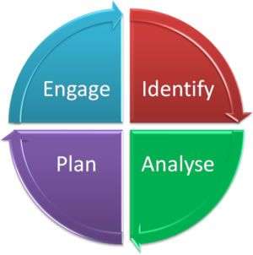
What is stakeholder management?
The process of (systematic) identification, analysis, planning, engaging and all other kinds of activities in terms of managing stakeholders.
-Jing et al. and Stakeholdermap-
Jing et al., 2011 . https://www.tandfonline.com/doi/abs/10.1080/01446193.2010.521759
https://www.stakeholdermap.com/stakeholder-management.html

Slide 12
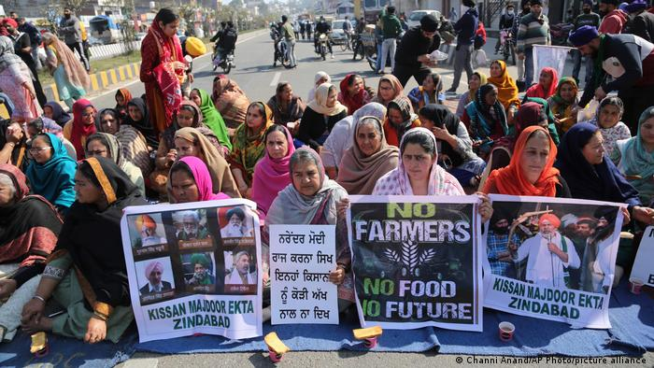
Why stakeholder management in decision analysis?
Affecting
Affected
https://www.kepner-tregoe.com/blog/decisions-managing-the-stakeholders/
https://www.dw.com/en/why-are-indias-farmers-protesting/a-56480047
https://www.romanpichler.com/blog/stakeholder-engagement-analysis-power-interest-grid/
https://www.researchgate.net/publication/228598959_Stakeholder_Categorisation_in_Participatory_Integrated_Assessment_Processes

Slide 13
Stakeholder Management Process in
decision analysis
Stakeholder Identification
Stakeholder Categorization and Analysis
2.1. Identifying experts
2.2. Interest and power analysis
Stakeholder Planning
Stakeholder Engagement
https://www.researchgate.net/publication/228598959_Stakeholder_Categorisation_in_Participatory_Integrated_Assessment_Processes
https://www.stakeholdermap.com/stakeholder-management.html

Slide 14
Stakeholder Management Process
Stakeholder Identification
Stakeholder Categorization and Analysis
2.1. Identifying experts
2.2. Interest and power analysis
Stakeholder Planning
Stakeholder Engagement
https://www.researchgate.net/publication/228598959_Stakeholder_Categorisation_in_Participatory_Integrated_Assessment_Processes
https://www.stakeholdermap.com/stakeholder-management.html

Slide 15
Step 1: Stakeholder Identification
“Any group or individual who can affect or is affected by the achievement of the organization's objectives”. (Freeman, 1984)
Any naturally occurring entity that is affected by organizational performance.
(Starik, 1995)
Any individual or group who has an interest in the project or is impacted by the project
(Bourne, 2005).
https://www.cambridge.org/core/books/strategic-management/E3CC2E2CE01497062D7603B7A8B9337F
https://www.researchgate.net/publication/242340540_Project_relationship_management_and_the_Stakeholder_CircleTM
https://www.jstor.org/stable/25072639
Stakeholder | Definition - What is a stakeholder? https://www.stakeholdermap.com/stakeholder-definition.html
https://www.subpng.com/png-84unkb/
https://www.stakeholdermap.com/stakeholder-management.html
https://www.dreamstime.com/photos-images/criteria-word.html

Slide 16

Step 1: Stakeholder Identification
Any individual or group who has an interest in the a decision and/or who can affect or is affected by a decision
- Based on-
(Freeman, 1984, Bourne, 2005)
Male, female or other gender
Senior or junior levels
Individuals or groups
Rich or poor
Powerful or weak
Saboteurs or champions
Activists or advocates
Internal or external
But!!! What if there are too many stakeholders?
https://www.stakeholdermap.com/stakeholder-definition.html
https://www.dreamstime.com/photos-images/criteria-word.html

